Slide 1
Physical Activity Fitness Prediction Using Machine Learning
SUBMITTED BY
VELLURU VARSHITH

Slide 2
Project Idea:
Sedentary lifestyle is defined by the absence of physical activity practices throughout the day and causes a decrease in caloric expenditure. This behavior is explained by the inappropriate lifestyle, for example, too much time sitting or lying down and still eating unhealthy foods during this time of immobilization. Currently, a third of the adult world population is physically inactive and this generates 5 million deaths per year (The LAncet, 2012). In addition to contributing to several chronic diseases, physical inactivity also influences mood, sleep quality and body weight
The objective of the project is answering a simple question, “does exercise/working-out improve a person’s activeness?”. For the scope of this project a person’s activeness was the measure of their daily step-count (the number of steps they take in a day). We are going to build a Machine Learning model which predicts the activeness or inactiveness of a person based on the Mood and number of steps taken in a day. Mood was measured in either "Happy", "Neutral" or "Sad" which were given numeric values of 300, 200 and 100 respectively. Feeling of activeness was measured in either "Active" or "Inactive" which were given numeric values of 500 and 0 respectively.

Slide 3
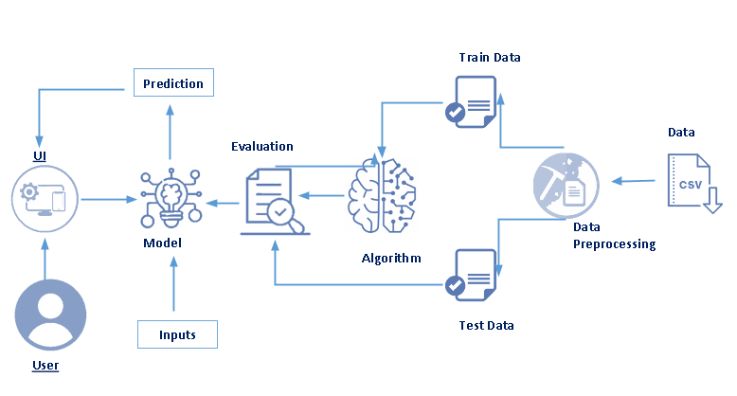
Architecture:

Slide 4
Project Outcomes :
By the end of this project:
You’ll be able to understand the problem to classify if it is a regression or a classification kind of problem.
You will be able to know how to pre-process / clean the data using different data pre-processing techniques.
You will be able to analyze or get insights of data through visualization.
Applying different algorithms according to dataset and based on visualization.
You will be able to know how to find the accuracy of the model.
You will be able to know how to build a web application using the Flask framework.

Slide 5
Project Workflow:
User interacts with the UI (User Interface) to upload the input features.
Uploaded features/input is analyzed by the model which is integrated
Once a model analyses the uploaded inputs, the prediction is showcased on the UI.
Tasks:
Data Collection.
Collect the dataset or Create the dataset
Data Pre- processing.
Import the Libraries.
Importing the dataset.
Exploratory Data Analysis
Checking for Null Values.
Data Visualization.
Splitting Data into Train and Test.
Model Building
Training and testing the model
Evaluation of Model
Application Building
Create an HTML file
Build a Python Code.

Slide 6
Importing The Libraries:
Pandas: It is a python library mainly used for data manipulation.
NumPy: This python library is used for numerical analysis.
Counter: Python Counter is a container that will hold the count of each of the elements present in the container.
Matplotlib and Seaborn: Both are the data visualization library used for plotting graphs which will help us to understand the data.
Accuracy score: used in classification type problems and for finding accuracy it is used.
R2 Score: Coefficient of Determination or R² is another metric used for evaluating the performance of a regression model. The metric helps us to compare our current model with a constant baseline and tells us how much our model is better.
Train_test_split: used for splitting data arrays into training data and for testing data.
Pickle: to serialize your machine learning algorithms and save the serialized format to a file.

Slide 7
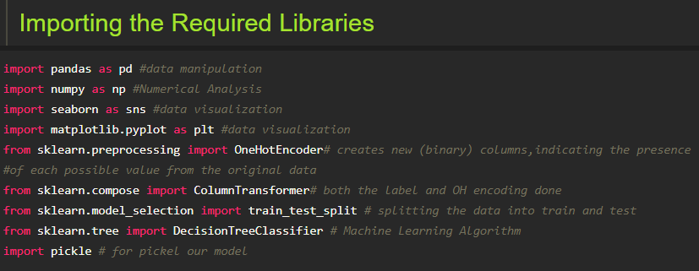

Slide 8

Reading The Dataset:
You might have your data in .csv files, .excel files or .tsv files or something else. But the goal is the same in all cases. If you want to analyse that data using pandas, the first step will be to read it into a data structure that’s compatible with pandas.
Let’s load a .csv data file into pandas. There is a function for it, called read_csv().We will need to locate the directory of the CSV file at first (it’s more efficient to keep the dataset in the same directory as your program).
Path names on Windows tend to have backslashes in them. But we want them to mean actual backslashes, not special characters.

Slide 9
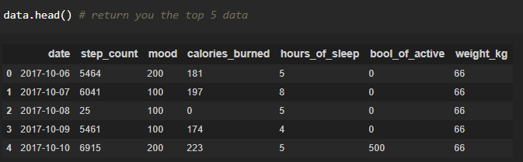
Exploratory Data Analysis
Exploratory data analysis is an approach to analyzing data sets to summarize their main characteristics, often with visual methods and used for determine how best to manipulate data sources to get the answers you need, making it easier for data scientists to discover patterns, spot anomalies, test a hypothesis, or check assumptions. To check the first five rows of the dataset, we have a function called head( ).

Slide 10
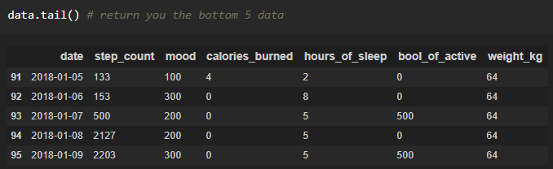
This head () function returns the first 5 rows for the object based on position. It is useful for quickly testing if your object has the right type of data in it.
To check the last five rows of the dataset, we have a function called tail().

Slide 11
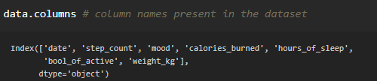
For finding the names of the columns present in the dataset we make use of columns
data.columns will return you all the column names which are present in your data
Understanding Data Type and Summary of features:
How the information is stored in a DataFrame or Python object affects what we can do with it and the outputs of calculations as well. There are two main types of data : numeric and text data types.
Numeric data types include integers and floats.
Text data type is known as Strings in Python, or Objects in Pandas. Strings can contain numbers and / or characters.
For example, a string might be a word, a sentence, or several sentences.
Will see how our dataset is, by using the info() method.

Slide 12
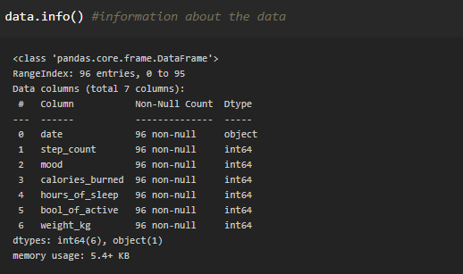
As you can see in our dataset there are both numerical and categorical data present, but it is not necessary that all the continuous data which we are seeing has to be continuous in nature. There may be a case that some categorical data is in the form of numbers but when we perform info() operation we will get numerical output. So, we need to take care of those types of data also.

Slide 13
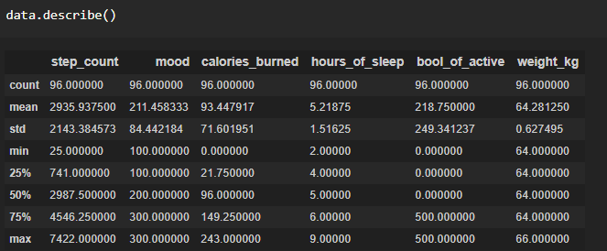

describe() functions are used to compute values like count, mean, standard deviation and IQR(Interquartile Ranges) and give a summary of numeric type data. Observing Target, Numerical and Categorical Columns

Slide 14
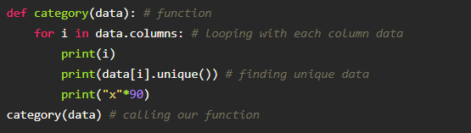
Here, data.dtypes will return us all the different types of data present in our data and return_counts will give us the count.
Let’s start observing the categorical and numerical columns and check whether the above count is correct or not.
Selecting the Categorical features Creating a function to fetch the number of unique elements present in each column. The columns which are having a minimum number of unique elements or category present will be considered as the categorical columns and the remaining columns will be a numerical column.

Slide 15
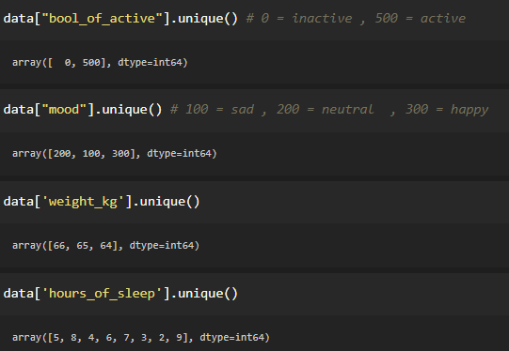

Slide 16
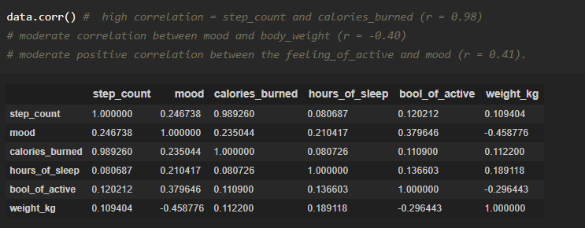
Finding the Correlation Correlation is a statistic that measures the degree to which two variables move in relation to each other.

Slide 17
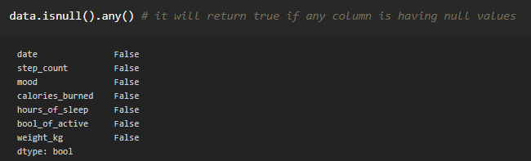
Checking For Null Values:
Sometimes you may find some data is missing in the dataset. We need to be equipped to handle the problem when we come across them. Obviously, you could remove the entire line of data but what if you are unknowingly removing crucial information? Of course we would not want to do that. One of the most common ideas to handle the problem is to take a mean of all the values for continuous and for categorical we make use of mode values and replace the missing data. We will be using isnull().any() method to see which column has missing values.

Slide 18
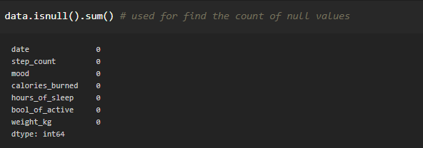
Word “True” that the particular column has missing values, we can also see the count of null values in each column by using isnull().sum().
As our data is not having any null values so we don’t have to handle the null values but by using the seaborn heatmap libraries we can observe the null values graphically.

Slide 19
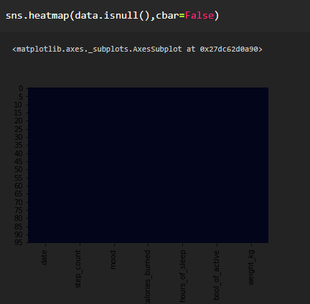

Slide 20
Label Encoding
Typically, any structured dataset includes multiple columns with a combination of numerical as well as categorical variables. A machine can only understand the numbers. It cannot understand the text. That’s essentially the case with Machine Learning algorithms too. We need to convert each text category to numbers in order for the machine to process those using mathematical equations. How should we handle categorical variables? There are Multiple ways to handle, but will see one of it is Label Encoding.
Label Encoding is a popular encoding technique for handling categorical variables. In this technique, each label is assigned a unique integer based on alphabetical ordering.
Let’s see how to implement label encoding in Python using the scikit-learn library.
As we have to convert only the text class category columns, we first select it then we will implement Label Encoding to it.

Slide 21
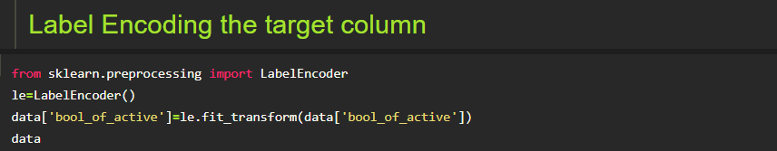
In the above code we are changing the category of our target column by performing label encoding

Slide 22
Data Visualization
Data visualization is where a given data set is presented in a graphical format. It helps the detection of patterns, trends and correlations that might go undetected in text-based data. Understanding your data and the relationship present within it is just as important as any algorithm used to train your machine learning model. In fact, even the most sophisticated machine learning models will perform poorly on data that wasn’t visualized and understood properly.
To visualize the dataset we need libraries called Matplotlib and Seaborn. The Matplotlib library is a Python 2D plotting library which allows you to generate plots, scatter plots, histograms, bar charts etc.
Let’s visualize our data using Matplotlib and seaborn library.
Univariate Analysis
Univariate analysis is the simplest form of data analysis where the data being analyzed contains only one variable.
Plotting histograms for some of the columns of our data

Slide 23
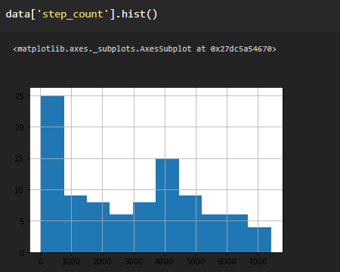
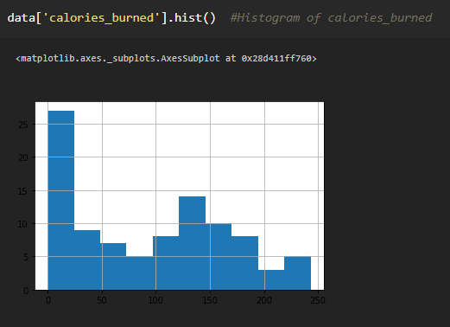
step_count
calories_burned

Slide 24
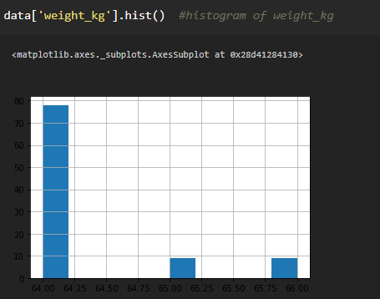
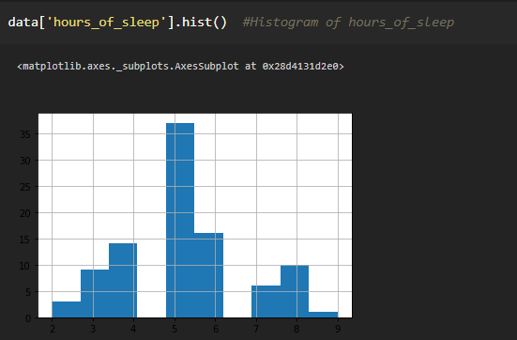
weights_kg
hours_of_sleep

Slide 25
Finding correlation between the independent Columns
Correlation is a statistical relationship between two variables and it could be positive, meaning both variables move in the same direction, or negative, meaning that when one variable's value increases, the other variables' values decrease.
With the help of seaborn heatmap we will be plotting the heatmap and for finding the correlation between variables we have corr() available.

Slide 26
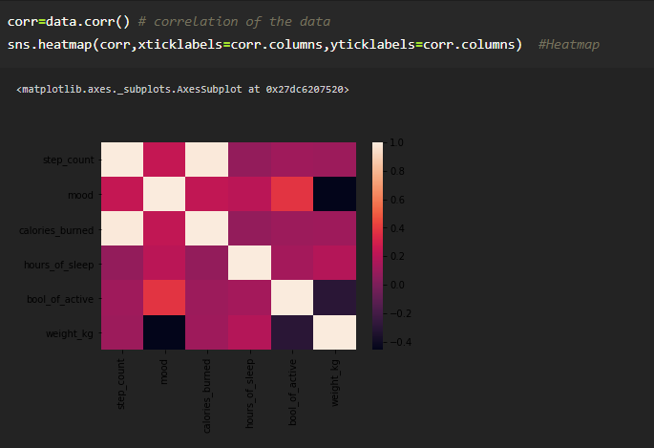
If you observe the heatmap, lighter the colour the correlation between those two variables will be high.
And correlation plays a very important role for extracting the correct features to build our model.

Slide 27
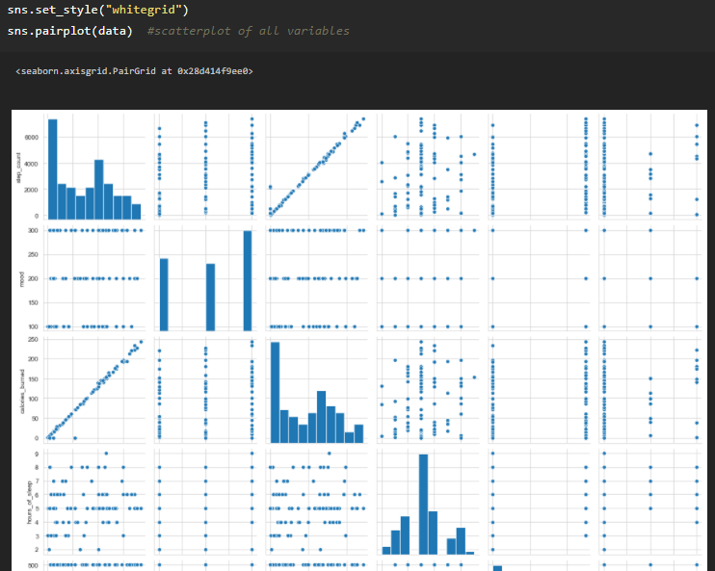
Plotting a pair plot to showcase the relationship among all the different columns

Slide 28
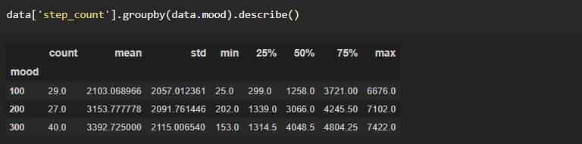
Bivariate Analysis
It involves the analysis of two variables (often denoted as X, Y), for the purpose of determining the empirical relationship between them.
Let’s plot all the possible bivariate analyses one by one to analyze the relation between them.
Before plotting the plot for analysis, we will be grouping the columns with our target column to check the relationship between our target column only.
We will make use of group by function to making the groups according to our requirements and then by using a bar plot showcase the visualization
step count vs mood

Slide 29
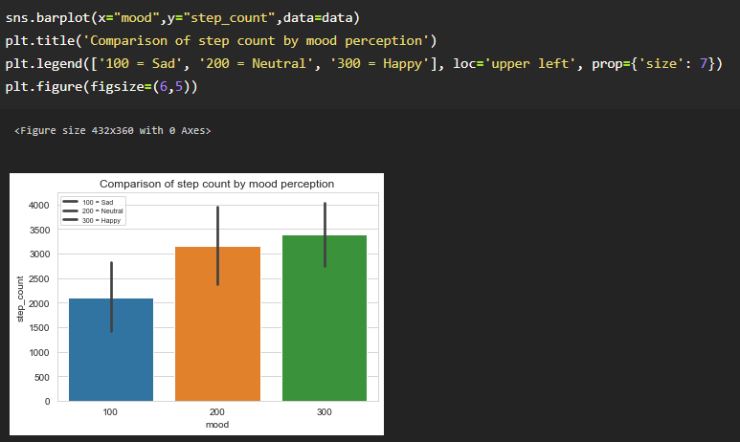

Slide 30
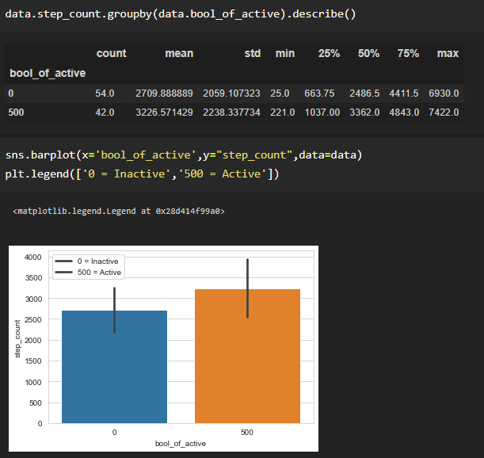
Step_count vs Activeness

Slide 31
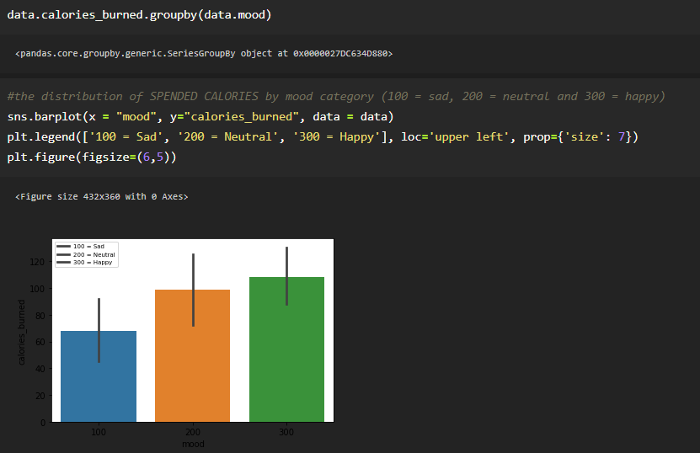
Mood vs Calories_burned
In the similar way what we did in the previous visualizations you can plot the graphs for ,
Calories_burned vs Activeness
Sleeping_hours vs mood
Sleeping_hours vs Activeness
Mood vs Activeness

Slide 32
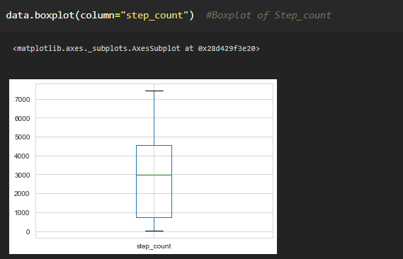
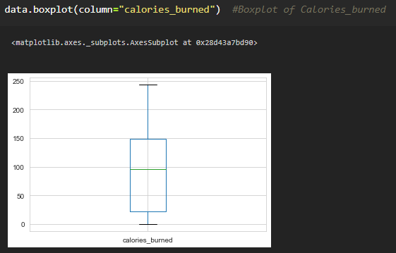
Outliers Detection using boxplot
Outliers are observations in a dataset that don't fit in some way or you can say those values are of no use and also may effect our results.
So with the help of boxplot we can visualize and check whether the data contains any outliers or not.

Slide 33
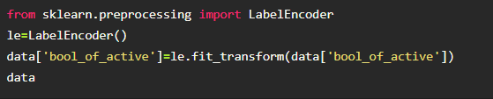
Label Encoding of target data
As in our target data we have two classes i,e. 0(Inactive) , 500 (active) we will be using a label encoding technique to encode it to 0 and 1 for better understanding of the classes.

Slide 34
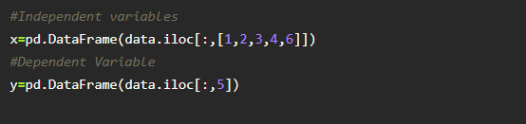
Splitting The Dataset Into Dependent And Independent Variables
In machine learning, the concept of dependent variable (y) and independent variables(x) is important to understand. Here, Dependent variable is nothing but output in the dataset and the independent variable is all inputs in the dataset. We can denote with any symbol (alphabets). In our dataset we can say that class is the dependent variable and all other columns are independent. But in order to select the independent columns we will be selecting only those columns which are highly correlated and of some value to our dependent column.
With this in mind, we need to split our dataset into the matrix of independent variables and the vector or dependent variable. Mathematically, Vector is defined as a matrix that has just one column.
Let’s create out independent and dependent variables:
In the above code we are creating a DataFrame of the independent variable x with our selected columns and for dependent variable y we are only taking the class column.

Slide 35
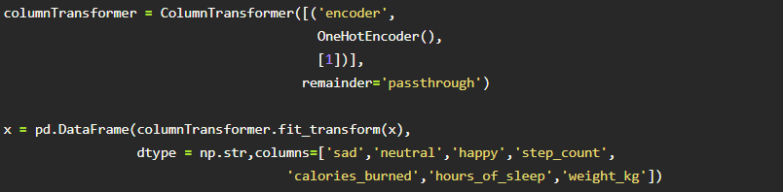
Column Transformer
Applies transformers to columns of an array or pandas DataFrame. This estimator allows different columns or column subsets of the input to be transformed separately and the features generated by each transformer will be concatenated to form a single feature space.
Column Transformer is a new approach where we apply both labels and one hot encoding in a single step.

Slide 36
Split The Dataset Into Train Set And Test Set
When you are working on a model and you want to train it, you obviously have a dataset. But after training, we have to test the model on some test dataset. For this, you will have a dataset which is different from the training set you used earlier. But it might not always be possible to have so much data during the development phase. In such cases, the solution is to split the dataset into two sets, one for training and the other for testing.
But the question is, how do you split the data? You can’t possibly manually split the dataset into two sets. And you also have to make sure you split the data in a random manner. To help us with this task, the Scikit library provides a tool, called the Model Selection library. There is a class in the library which is, ‘train_test_split.’ Using this we can easily split the dataset into the training and the testing datasets in various proportions.
The train-test split is a technique for evaluating the performance of a machine learning algorithm.
Train Dataset: Used to fit the machine learning model.
Test Dataset: Used to evaluate the fit machine learning model.

Slide 37
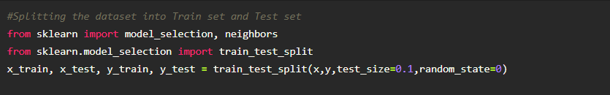
In general you can allocate 80% of the dataset to the training set and the remaining 20% to the test set.
We will create 4 sets— X_train (training part of the matrix of features), X_test (test part of the matrix of features), Y_train (training part of the dependent variables associated with the X train sets, and therefore also the same indices), Y_test (test part of the dependent variables associated with the X test sets, and therefore also the same indices.
There are a few other parameters that we need to understand before we use the class:
test size — this parameter decides the size of the data that has to be split as the test dataset. This is given as a fraction. For example, if you pass 0.5 as the value, the dataset will be split 50% as the test dataset
train size — you have to specify this parameter only if you’re not specifying the test size. This is the same as test size, but instead you tell the class what percent of the dataset you want to split as the training set.
random state — here you pass an integer, which will act as the seed for the random number generator during the split. Or, you can also pass an instance of the Random_state class, which will become the number generator. If you don’t pass anything, the Random_state instance used by np.random will be used instead.
Now split our dataset into a train set and test using the train_test_split class from scikit learn library

Slide 38
Model Building:
Train And Test The Model Using Decision Tree
There are several Machine learning algorithms to be used depending on the data you are going to process such as images, sound, text, and numerical values. The algorithms that you can choose according to the objective that you might have may be Classification algorithms are Regression algorithms.
Example:
1. Linear Regression.
2. Logistic Regression.
3. Random Forest Regression / Classification.
4. Decision Tree Regression / Classification.
You will need to train the datasets to run smoothly and see an incremental improvement in the prediction rate.

Slide 39
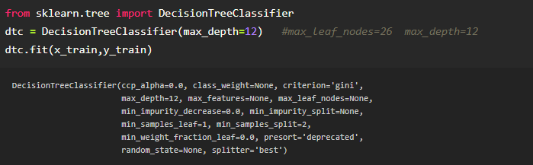
Now we apply the Decision Tree algorithm on our dataset.
A decision tree is a decision support tool that uses a tree-like model of decisions and their possible consequences, including chance event outcomes, resource costs, and utility. It is one way to display an algorithm that only contains conditional control statements.
Build the model with the Decision Tree Classifier.
We’re going to use x_train and y_train obtained above in train_test_split section to train our decision tree classifier model. We’re using the fit method and passing the parameters as shown below.

Slide 40
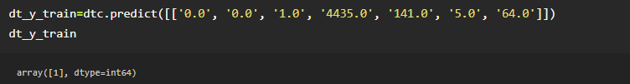
Predict the values
Once the model is trained, it’s ready to make predictions. We can use the predict method on the model and pass x_test as a parameter to get the output as dt_y_train.
Notice that the prediction output is an array of real numbers corresponding to the input array.

Slide 41


Model Evaluation
inally, we need to check to see how well our model is performing on the test data. There are many evaluation techniques. For this, we evaluate scores produced by the model.
Save the Model
Pickle is used for serializing and de-serializing Python object structures, also called marshalling or flattening. Serialization refers to the process of converting an object in memory to a byte stream that can be stored on disk or sent over a network. Later on, this character stream can then be retrieved and de-serialized back to a Python object.
Save our model by importing pickle file.
Here, dtc is our decision tree classifier class with saving as fitness.pkl file. Wb is the write binary in bytes.

Slide 42
Application Building
Create An HTML File
We use HTML to create the front end part of the web page.
Here, we created 2 html pages- index.html, web.html.
index.html displays the home page.
web.html accepts the values from the input and displays the prediction.
For more information regarding HTML
We also use JavaScript-main.js and CSS-main.css to enhance our functionality and view of HTML pages.
Build Python Code
Let us build a flask file ‘app.py’ which is a web framework written in python for server-side scripting. Let’s see the step by step procedure for building the backend application.
App starts running when the “__name__” constructor is called in main.
render_template is used to return an html file.
“GET” method is used to take input from the user.
“POST” method is used to display the output to the user.

Slide 43
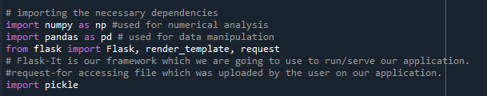
Importing Libraries
Libraries required for the app to run are to be imported.
Creating our flask app and loading the model
Now after all the libraries are imported we will be creating our flask app and then load our model into our flask app.

Slide 44
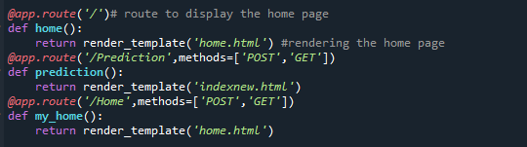
Routing to the html Page:
Basically, we give routes of our html pages in order to showcase the UI. By giving the routes the built code in the html page is connected to our flask app. This is how a UI can be built and showcased.
We are routing the app to the html templates which we want to render.
Firstly, we are rendering the home.html template and from there we are navigating to our prediction page that is indexnew.html

Slide 45
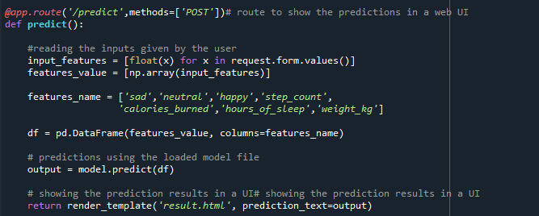
Lastly, we run our app on the local host.
Here we are running it on localhost:5000

Slide 46
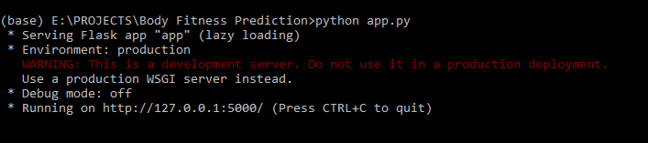
Run The App
Open anaconda prompt from the start menu
Navigate to the folder where your python script is.
Now type “python app.py” command
Navigate to the localhost where you can view your web page
Showcasing The UI

Slide 47
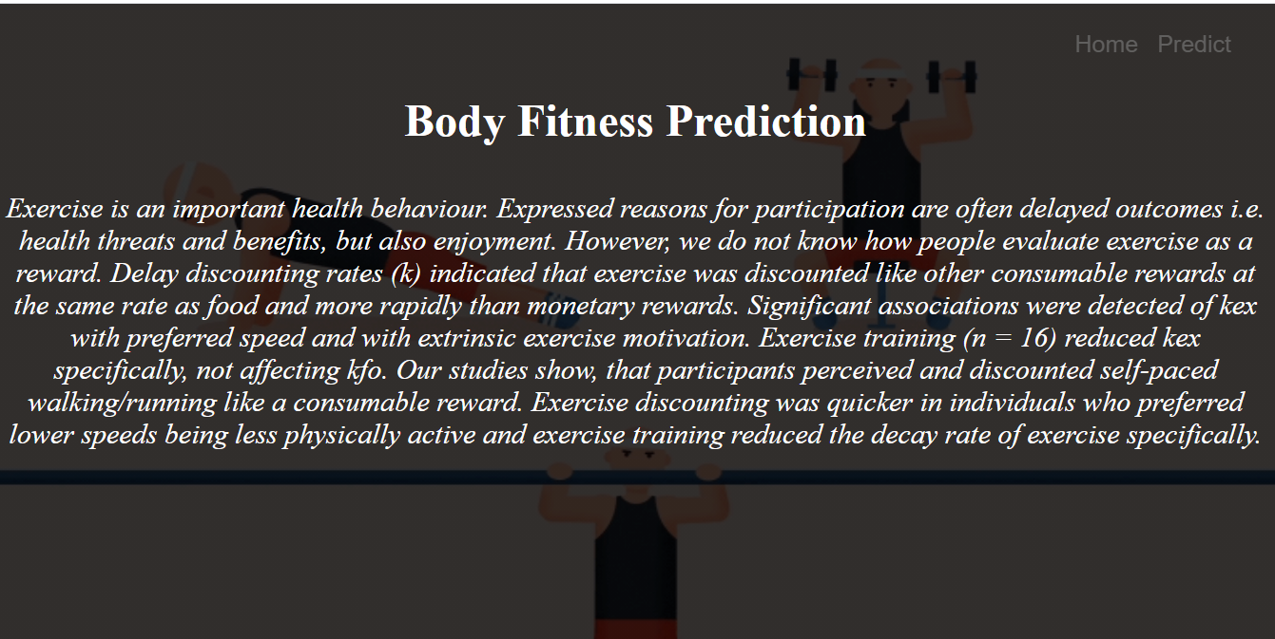

Slide 48
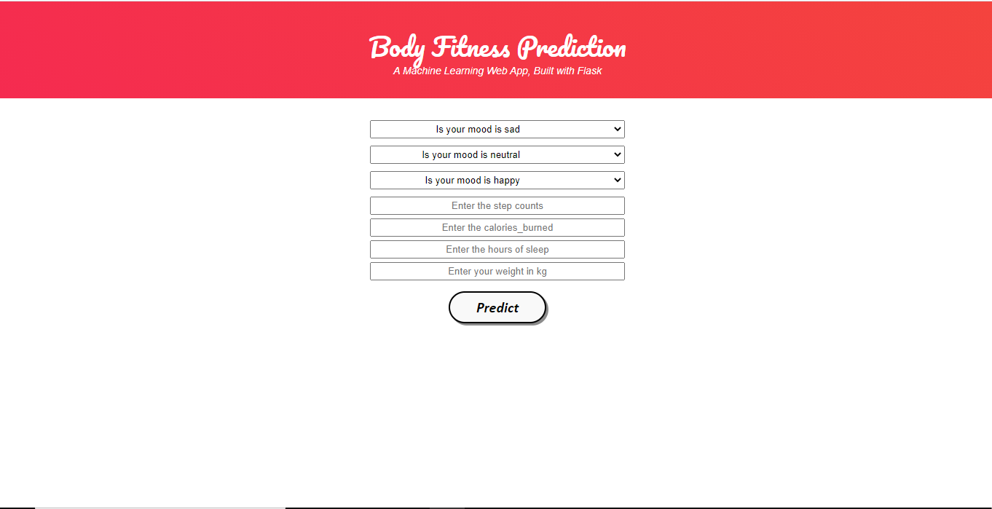
This is the home main page that describes the project and summarizes it.

Slide 49
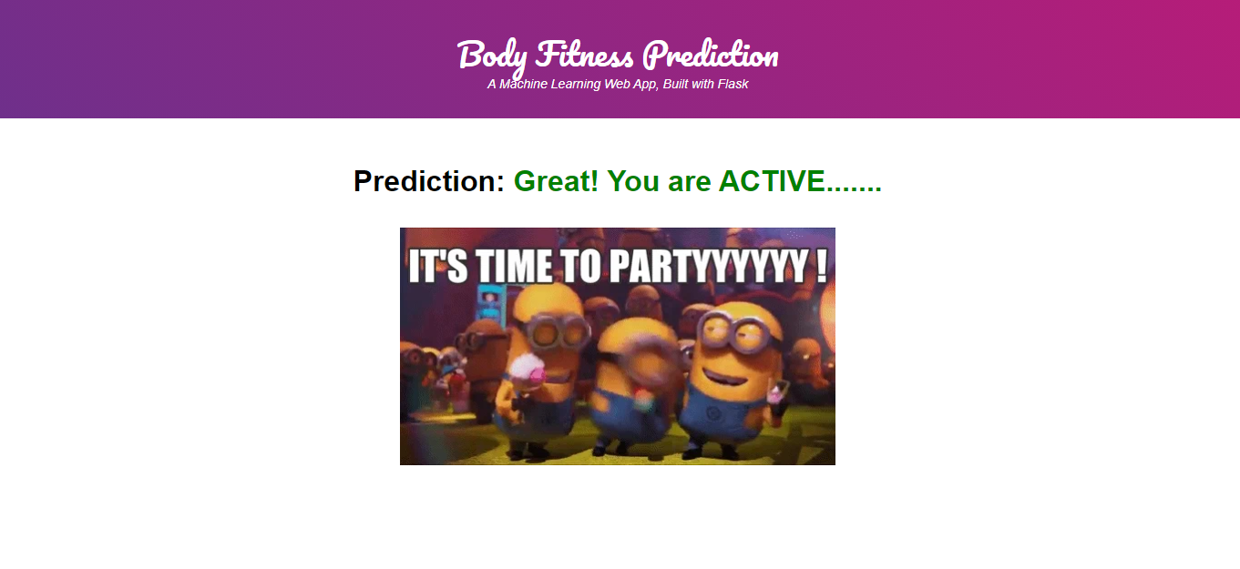
This is the prediction page where we get to choose the input from our local system and predict the output.
Finally, the prediction for the given input features is shown.

